Slide 1

Pagerank in a nutshell
Hubert Ruczyński

Slide 2
Pagerank (PR) origins
PageRank is a link/network analysis algorithm that Google Search originally used to rank websites in its search results. It is named after Larry Page, one of Google's co-founders. PageRank uses a mathematical algorithm to estimate the importance of a website based on the links it receives from other websites. This metric helps Google determine which websites are more authoritative and relevant to a particular search query.
The PageRank assumes that there is a "random surfer" who is given a web page at random and keeps clicking on links, never hitting "back„. What it tries to establish is the simulation of this process, which is similar to a random walk on a Markov Chain.

Slide 3
Reasoning behind PR – in-degree
Intuitively, to measure the importance of a given node, we can simply, count the number of incoming edges (in-degree). Next, we calculate that for all nodes and normalize it with the division by the sum of all node degrees, obtaining an in-degree distribution.
PR(vi) = in_deg(vi) / sum(in_deg(V))
PR(V) = [PR(v1), PR(v2),…]
This measure however is not complete, as it doesn’t measure the importance of nodes that point to that vertex.

Slide 4
Reasoning behind PR – importance
In order to include information about the rank of vertices that point to the considered node, we have to weigh them somehow. The original idea is to calculate all nodes (ti) PR and divide it by the number of outgoing links (C(ti)).
PR(vi) = PR(t1)/C(t1) + … + PR(tn)/C(tn)
How to calculate the first PR values, as they depend on the PRs of other nodes? We simply have to initialize PR values with equal values (1/|V|), and then start the iteration process.
However, if we simulate a „random surfer”, we should consider the cases where we get into loops or end-nodes.

Slide 5
Reasoning behind PR – damping
To represent this quality, we introduce a variable d, called the damping factor.
It represents the probability that the „random surfer” will stay on topic, and use the original network. Otherwise, with probability 1-d he can jump into a completely random page. The literature advises to set its value as 0.95.
Finally, we can get a real definition of PageRank value:
PR(vi) = (1-d) + d(PR(t1)/C(t1) + … + PR(tn)/C(tn))
And to calculate it, we start from an even distribution, and then count PR for each node based on previous values, till we reach the given number of iterations.

Slide 6
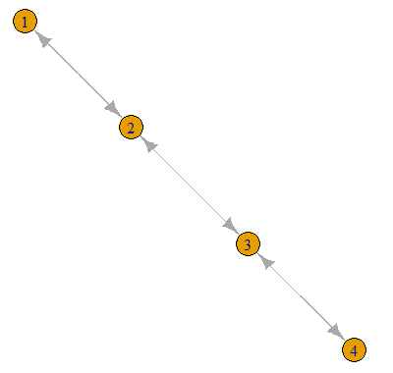
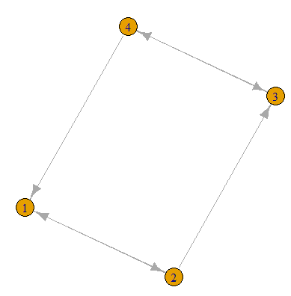
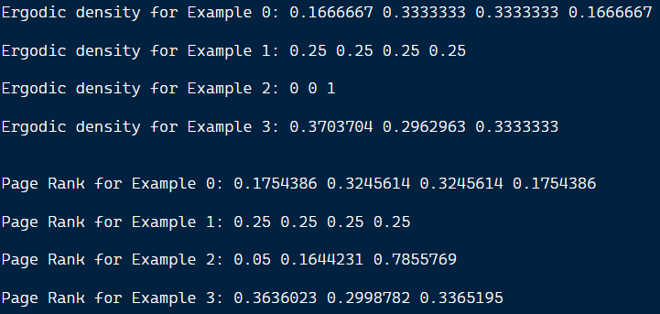
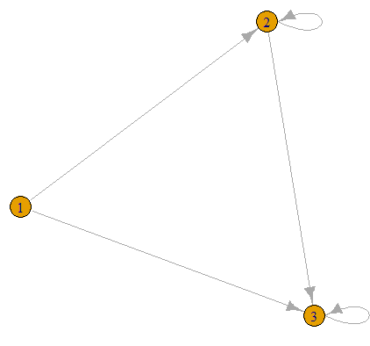
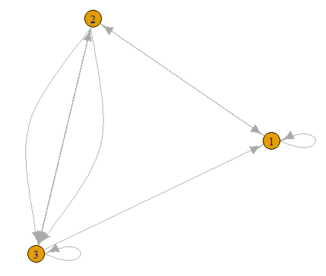
PR vs Ergodic density
As a bonus, I provide a comparison of results obtained by calculating ergodic density and PageRank for simple networks. We can see that the ergodic version is closer to theoretical results than PR, and it comes purely from the introduction of the damping factor.

Slide 7
Thank you for your attention!

